Slide 1


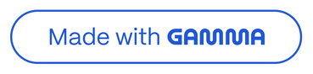
Meetup Platform - Comprehensive Project Synopsis
Project Title
Vijay Gholve
Notes:
1

Slide 2
Abstract
ConnectLocal is envisioned as a robust, full-stack web application designed to facilitate the discovery, creation, and management of local community groups and events. This platform aims to bridge the gap between individuals sharing common interests, enabling seamless organization of meetups, workshops, and social gatherings. It will feature intuitive group and event management tools, integrated communication channels, and a user-centric interface, fostering stronger local communities and enhancing social connectivity. The system prioritizes ease of use, scalability, and data security to provide a reliable and engaging experience for all participants.
Notes:
2

Slide 3
Introduction
Motivation
In an increasingly digital world, genuine local connections and shared experiences remain vital for community well-being and personal development. However, individuals often face challenges in discovering local groups aligned with their specific interests, organizing events efficiently, and managing attendee participation. Existing solutions may be fragmented, geographically limited, or lack the comprehensive tools required for effective community building. The motivation for developing ConnectLocal stems from the recognized need for an accessible, integrated, and user-friendly platform that empowers individuals to forge meaningful local connections and collectively pursue shared passions.
Notes:
3

Slide 4
Problem Statement
The current landscape for local community engagement and event organization is characterized by several significant challenges:
Discovery Fragmentation: Individuals struggle to efficiently discover local groups and events that align with their niche interests, often relying on disparate social media platforms or word-of-mouth.
Organizational Inefficiency: Group organizers face difficulties in managing member lists, scheduling events, collecting RSVPs, and disseminating timely updates through unintegrated tools.
Limited Engagement Tools: Existing platforms may lack robust features for fostering ongoing communication, discussion, and feedback within groups, hindering community cohesion.
Accessibility Barriers: Some platforms present complex interfaces or are not optimized for diverse user demographics, creating barriers to participation.
Data Siloing: Information regarding group activities, member demographics, and event attendance often remains siloed, preventing organizers from gaining comprehensive insights for future planning.
Monetization Challenges: For groups requiring fees or donations, integrated and secure payment processing solutions are often absent or cumbersome.
Notes:
4

Slide 5
Purpose/Objectives and Goals
The overarching purpose of the ConnectLocal project is to develop a comprehensive and intuitive web platform that simplifies the process of creating, joining, and managing local community groups and events, thereby fostering stronger social bonds and facilitating shared experiences.
Our primary objectives are:
Enhance Group and Event Discovery: To provide users with advanced search and recommendation functionalities to easily find relevant groups and events.
Streamline Event Organization: To empower group administrators with efficient tools for event scheduling, member management, and communication.
Facilitate Community Interaction: To integrate robust communication features that promote active engagement and discussion within groups.
Ensure Platform Accessibility and Usability: To design an intuitive and responsive user interface that caters to a broad user base.
Provide Actionable Analytics: To offer organizers insights into group activity, event attendance, and member engagement.
The goals of ConnectLocal are to achieve these objectives through the implementation of core functionalities, including:
User registration and profile management.
Group creation, management, and moderation.
Event scheduling, RSVP tracking, and attendance management.
Integrated messaging and discussion forums.
Search, filtering, and recommendation engines for groups and events.
Basic analytics dashboards for group organizers.
Notes:
5

Slide 6






Literature Survey
A comprehensive literature survey was conducted to understand the current state of social networking, community platforms, and event management systems. This involved examining successful platforms such as Meetup.com, Facebook Groups, Eventbrite, and various niche community forums. The survey focused on:
Feature Set Comparison
Technological Architectures
User Engagement Strategies
Analyzing the core functionalities provided by leading platforms, including group creation, event scheduling, communication tools, and monetization models.
Investigating the underlying technologies and design patterns employed by scalable social and event platforms, including real-time communication frameworks and database solutions for large user bases.
Studying methodologies for fostering user participation, retention, and community growth, such as gamification, notification systems, and content moderation.
Security and Privacy Standards
UI/UX Design Trends
Reviewing best practices for user authentication, data encryption, and compliance with privacy regulations (e.g., GDPR, CCPA) pertinent to social platforms handling personal data.
Evaluating modern design principles for intuitive navigation, accessibility, and responsive layouts across diverse devices. The insights gleaned from this survey are instrumental in guiding the feature set, architectural design, and user experience strategy for ConnectLocal, ensuring it leverages proven methods while addressing identified gaps in existing solutions.
Notes:
6

Slide 7
Project Scope and Limitations
Project Scope: ConnectLocal is scoped as a full-stack web application.
User Management: Comprehensive user registration, profile creation, and authentication.
Limitations:
Advanced Monetization: While basic event fees might be supported, complex ticketing tiers or integrated payment processing beyond a single, primary gateway are out of initial scope.
Group Management: Functionality for creating, joining, leaving, and managing groups, including member roles and moderation tools.
Event Management: Tools for scheduling, promoting, and managing events within groups, including RSVP tracking and attendance marking.
Live Streaming/Virtual Event Hosting: The platform will primarily focus on in-person event organization; built-in live streaming or dedicated virtual event hosting features are not included in the initial release.
Communication: Integrated messaging features for group members and event attendees, alongside discussion boards.
Sophisticated AI Recommendations: Advanced, highly personalized AI-driven recommendations based on deep user behavior analysis are considered for future iterations.
Discovery: Advanced search, filtering, and basic recommendation capabilities for groups and events.
Basic Analytics: Dashboards for group organizers to view key metrics on group activity and event attendance.
Native Mobile Applications: The project will deliver a fully responsive web application; dedicated native iOS/Android apps are beyond the current scope.
Responsive Design: Optimized for seamless usage across desktop, tablet, and mobile devices.
Complex Venue Management: Detailed venue booking or resource allocation within venues is not a primary focus.
Internationalization: Initial development will focus on a single language (English), with multi-language support as a future enhancement.
Notes:
7

Slide 8
System Analysis
Existing Systems
The market currently features several platforms that facilitate social connections and event organization, each with distinct focuses. Notable examples include:
Meetup.com: A long-standing platform specifically designed for local groups and events based on shared interests.
Facebook Groups/Events: A widely used social media feature that allows users to create private or public groups and organize events.
Eventbrite: Primarily a ticketing and event management platform, often used for larger, public events.
Local Community Forums/Websites: Various smaller, often niche-specific, online forums or websites catering to particular local interests.
Notes:
8

Slide 9
Scope and Limitations of Existing Systems
While existing platforms offer valuable services, they often present limitations:
Meetup.com: May involve subscription fees for organizers, and its interface can sometimes feel dated. Discovery can be limited to its own ecosystem.
Facebook Groups/Events: Lacks dedicated, robust event management tools for complex needs, and privacy concerns or social media fatigue can deter some users. Its primary focus is broad social networking, not dedicated community building.
Eventbrite: Primarily a ticketing solution, it lacks the deep community-building and ongoing group interaction features essential for a true "meetup" platform.
Niche Forums: While effective for specific communities, they often lack modern UI/UX, scalability, or comprehensive event management features.
General Limitations: Many existing solutions may not offer real-time analytics, flexible role-based access for group management, or seamless integration of communication and event planning tools in a single, intuitive interface.
Notes:
9

Slide 10
Project Perspective, Features
ConnectLocal aims to provide a superior, integrated experience by focusing on:
Unified Ecosystem
User-Centric Design
A single platform for group discovery, event organization, communication, and analytics.
Prioritizing intuitive navigation and a clean, modern interface for all user roles.
Robust Group Management
Enhanced Discovery
Empowering organizers with fine-grained control over their groups and events.
Intelligent search and filtering to connect users with highly relevant communities.
Real-time Engagement
Scalability
Integrated chat, discussion forums, and notifications for dynamic interaction.
Designed to support a growing user base and a multitude of groups and events without performance degradation.
Notes:
10

Slide 11
Stakeholders
The success of ConnectLocal relies on effectively serving various stakeholders:
Primary Users:
Secondary Stakeholders:
Group Organizers: Individuals or entities responsible for creating and managing groups and events.
Local Businesses/Venues: Who might host events or offer services to groups.
Group Members/Event Attendees: Individuals who join groups and participate in events.
Community Organizations: Non-profits or associations looking to expand their reach and engagement.
Platform Administrators: The team responsible for maintaining the platform, user support, and overall system health.
Advertisers/Sponsors: Businesses interested in reaching the platform's user base (future consideration for monetization).
Notes:
11

Slide 12
Requirement Analysis
Functional Requirements
User Management: User registration, login/logout, profile creation/editing, password management (reset, change), account deactivation.
Group Management: Create/edit/delete groups, join/leave groups, set group privacy (public/private), manage group members (add, remove, assign roles), group discussion forums.
Event Management: Create/edit/delete events, set event details (date, time, location, description), RSVP functionality (attend, decline, maybe), attendee list management, event reminders/notifications.
Discovery & Search: Search groups by name/interest/location, search events by date/category/location, filter search results.
Communication: In-app messaging between group members, group-wide announcements, event-specific chat.
Notifications: Real-time notifications for new events, messages, RSVPs, and group updates.
Reporting & Analytics: Dashboard for organizers to view group member count, event attendance rates, and basic engagement metrics.
Content Moderation: Tools for administrators to moderate inappropriate group/event content or user behavior.
Notes:
12

Slide 13
Performance Requirements
Response Time: User interface actions (e.g., loading group pages, submitting RSVPs) should respond within 2-3 seconds under normal load.
Scalability: The system must support concurrent users (e.g., 10,000 active users) and manage a growing number of groups and events (e.g., 50,000 groups, 100,000 events) without significant performance degradation.
Availability: The platform should maintain 99.9% uptime, excluding scheduled maintenance.
Load Handling: The system should gracefully handle peak loads during popular event announcements or registration periods.
Notes:
13

Slide 14
Security Requirements
Authentication: Secure user authentication using industry-standard protocols (e.g., JWT, OAuth2).
Authorization: Robust role-based access control (RBAC) to ensure users only access authorized functionalities and data.
Data Encryption: All sensitive data (e.g., passwords, personal information) must be encrypted both in transit (SSL/TLS) and at rest (database encryption).
Input Validation: Comprehensive input validation to prevent common web vulnerabilities (e.g., SQL injection, XSS).
Privacy Compliance: Adherence to relevant data privacy regulations (e.g., GDPR, CCPA) for user data handling and consent.
Audit Trails: Logging of critical system actions for security monitoring and incident response.
Notes:
14

Slide 15
System Design
Design Constraints
Budget: Development and operational costs must remain within a defined budget.
Timeline: Project completion within a specified timeframe (e.g., 6-9 months for initial MVP).
Technology Stack: Adherence to a modern, scalable, and maintainable technology stack (e.g., Python/Django for backend, React for frontend).
Scalability: Design must accommodate future growth in user base and data volume.
Security: Design must inherently incorporate security best practices from the ground up.
Maintainability: Codebase must be clean, modular, and well-documented for future enhancements and bug fixes.
User Interfaces
The user interfaces for ConnectLocal will be designed with a strong emphasis on intuitiveness, responsiveness, and consistency.
Intuitive Navigation: Clear and logical navigation paths will guide users effortlessly through the platform, minimizing learning curves.
Responsive Design: The UI will dynamically adapt to various screen sizes (desktop, tablet, mobile) using a mobile-first approach, ensuring optimal usability across all devices.
Consistent Experience: A unified design language, including consistent typography, color palettes, and component styling, will be applied across the entire platform for a cohesive user experience.
Accessibility: Adherence to WCAG (Web Content Accessibility Guidelines) will ensure the platform is usable by individuals with disabilities, incorporating features like keyboard navigation, proper color contrast, and screen reader compatibility.
Visual Appeal: A clean, modern, and engaging aesthetic will be employed to enhance user satisfaction and encourage prolonged engagement.
Notes:
15

Slide 16
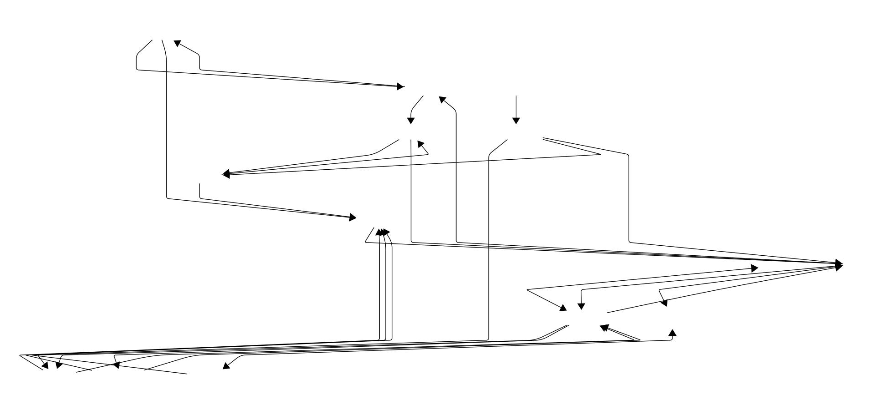
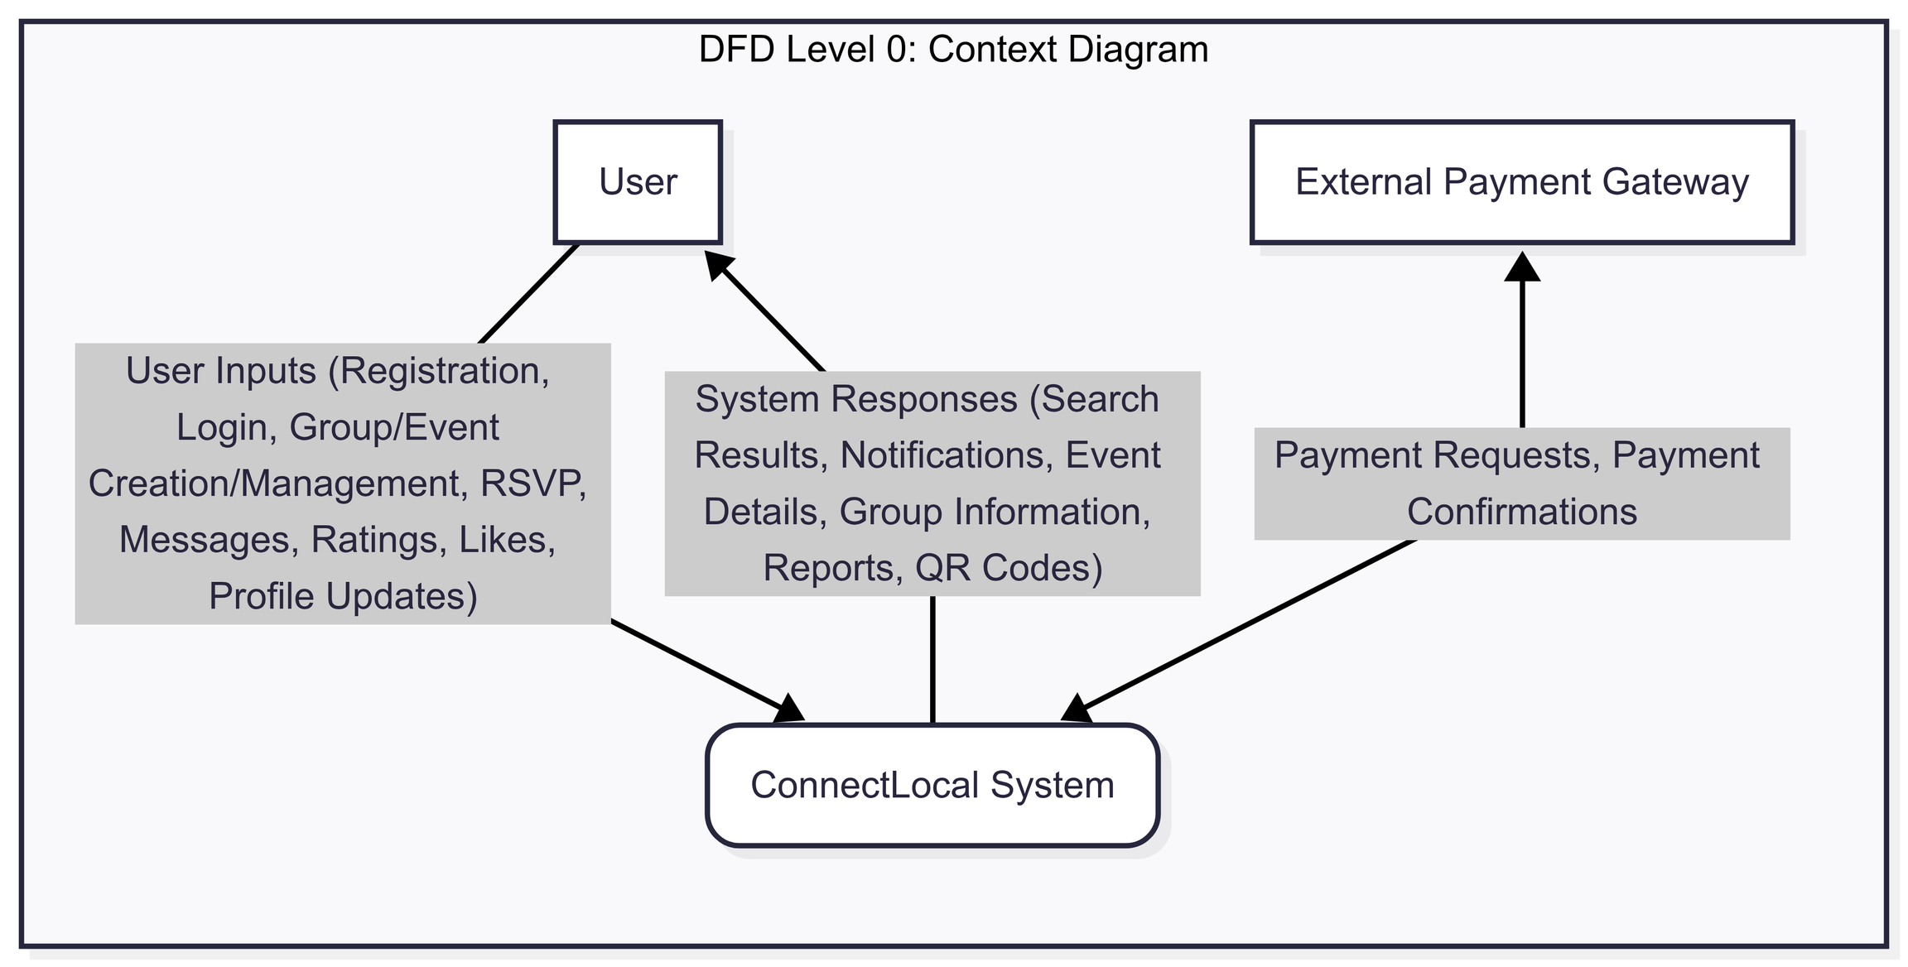
DFD LEVEL 0
Notes:
16

Slide 17
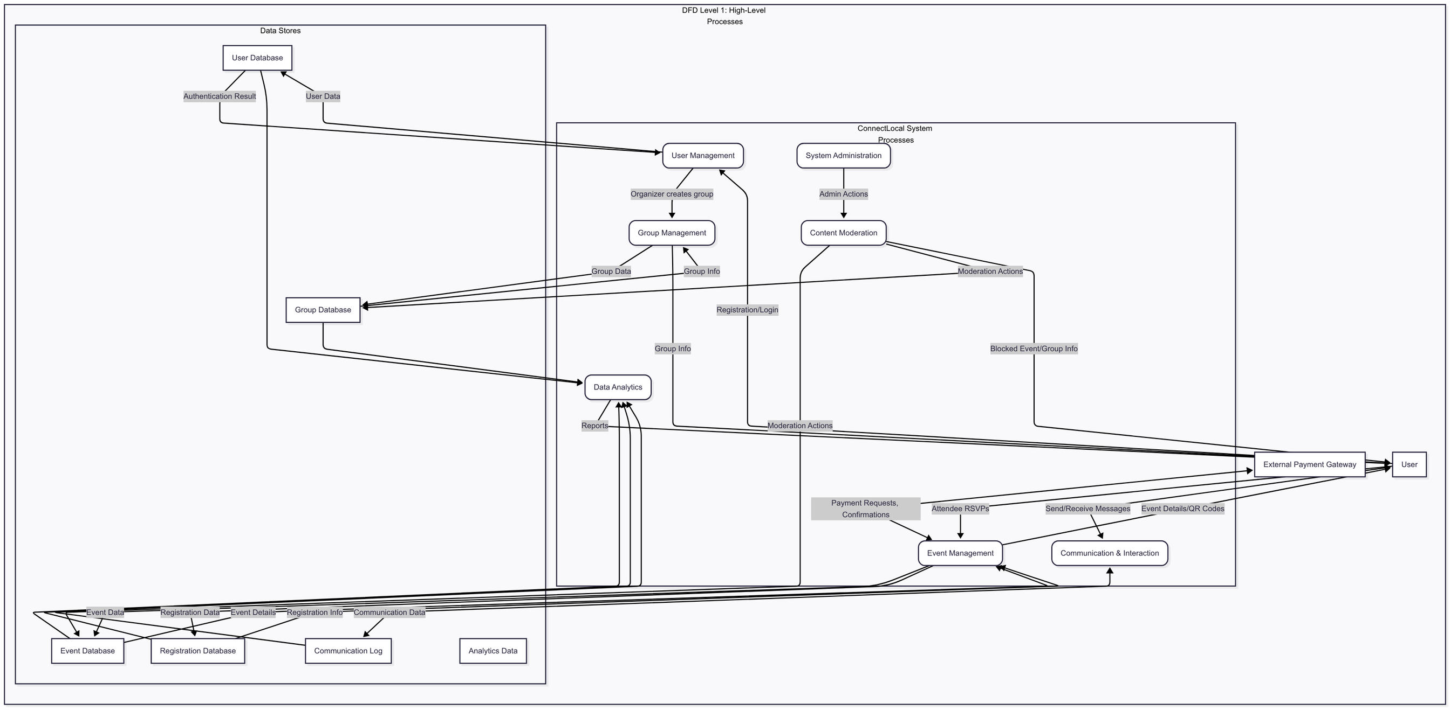
DFD LEVEL 1
Notes:
17

Slide 18
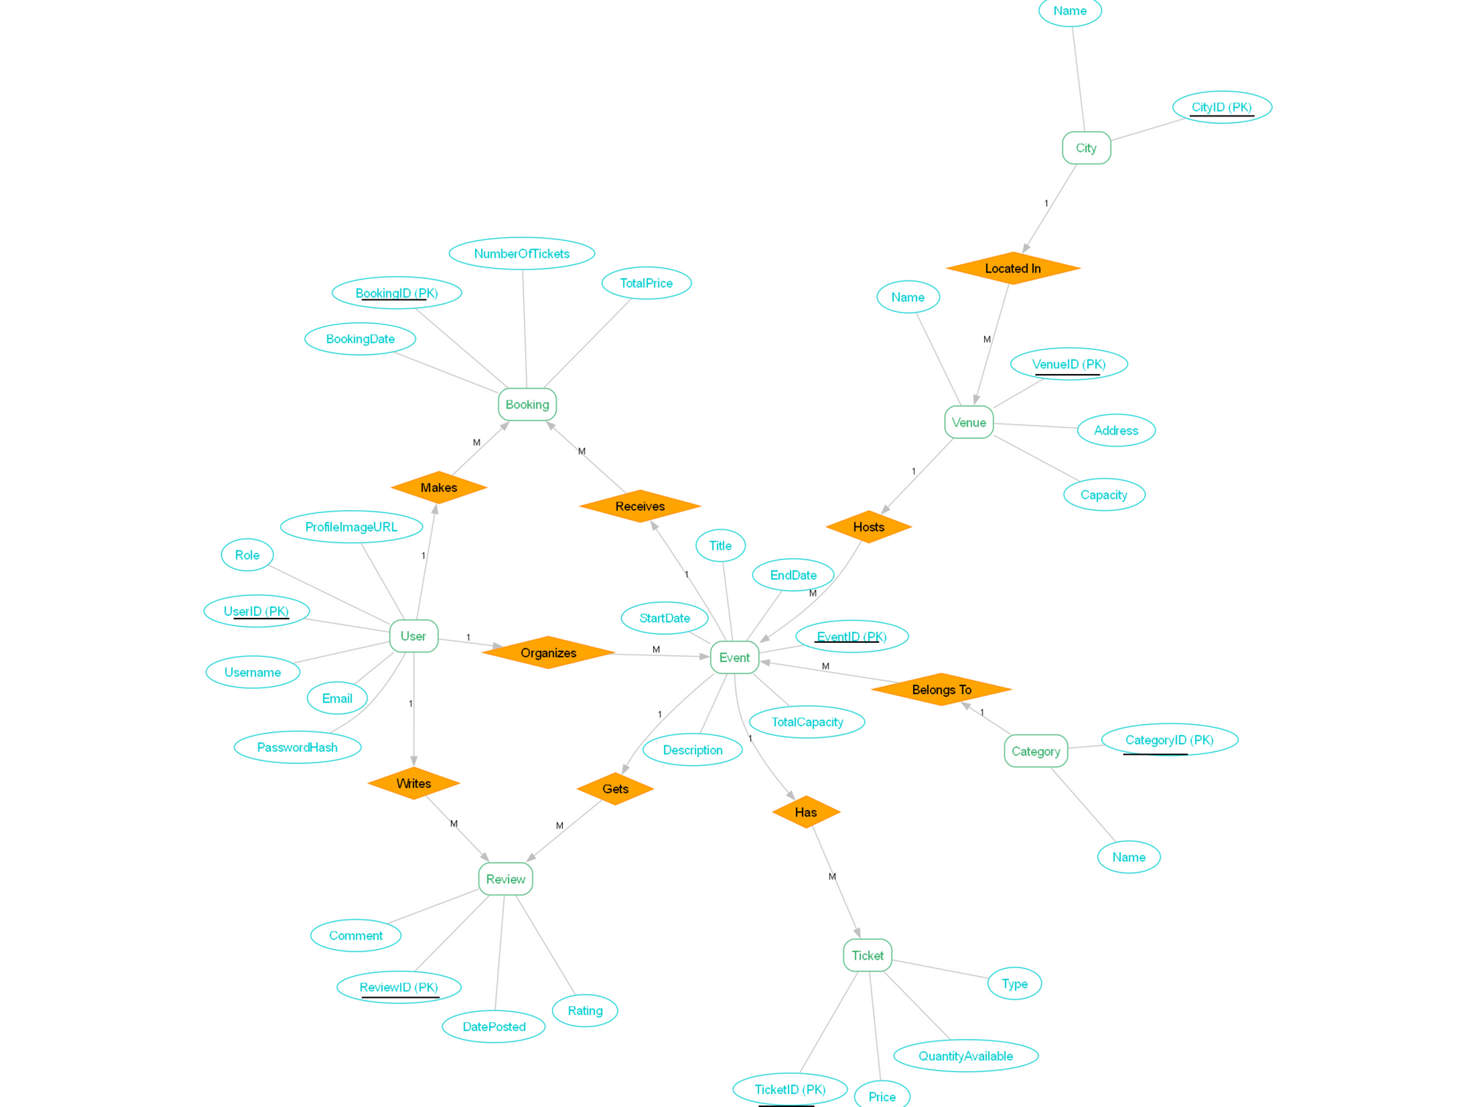
ER -
DIAGRAM
Notes:
18

Slide 19
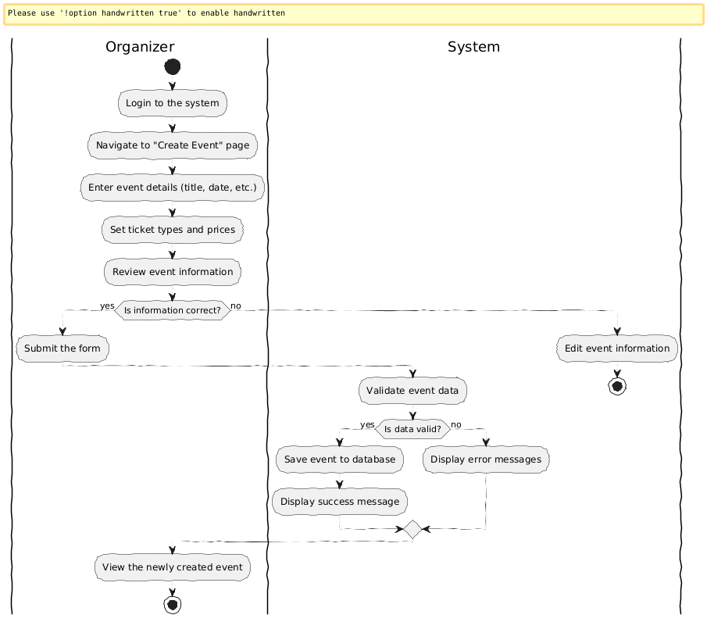
Activity
Diagram
Notes:
18

Slide 20
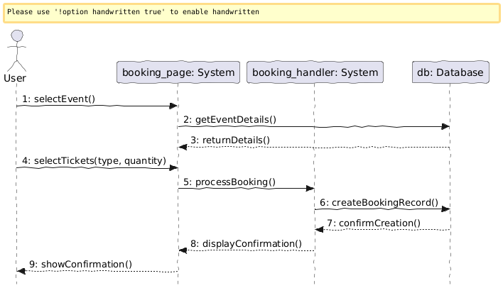
Collaboration diagram
Notes:
18

Slide 21
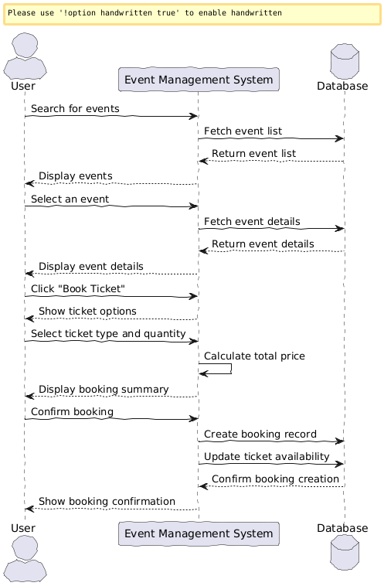
sequence diagram
Notes:
18

Slide 22
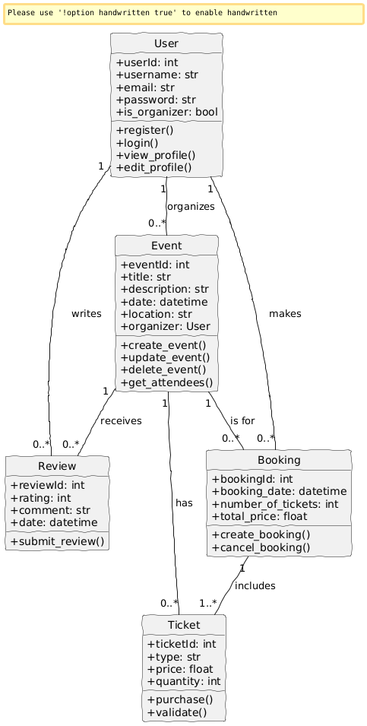
Class diagram
Notes:
18

Slide 23
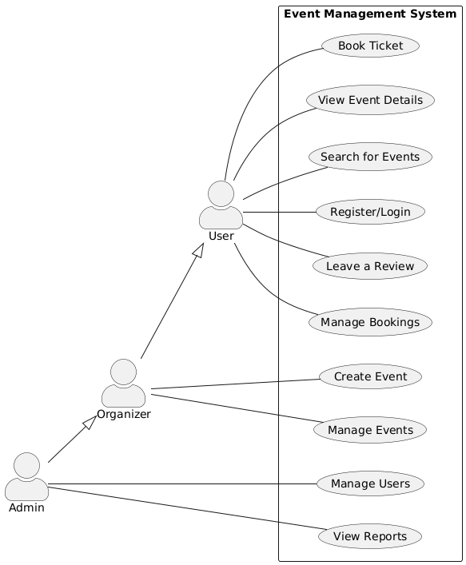
UseCase Diagram
Notes:
18

Slide 24
Implementation Details
Software/Hardware Specifications
Backend:
Frontend:
Language/Framework: Python 3.x with Django (latest stable version).
Language/Library: JavaScript with React (latest stable version).
API Framework: Django REST Framework.
Build Tool: Vite.
Database: PostgreSQL (for scalability and robust features).
Routing: React Router DOM.
Authentication: Django's built-in authentication system with JWT for API token management.
State Management: Redux Toolkit.
HTTP Client: Axios.
Image/File Handling: Pillow library for image processing.
UI Framework/Libraries: Tailwind CSS for utility-first styling, potentially Material-UI or Ant Design for robust components, Framer Motion for animations, Lucide React for icons.
Real-time Communication: Django Channels (for WebSockets) or a dedicated messaging queue (e.g., Redis Pub/Sub).
Deployment Environment: Cloud platform (e.g., AWS EC2/ECS, Google Cloud Run, Azure App Service) with containerization (Docker).
Version Control: Git (e.g., GitHub/GitLab).
Development Environment: Standard IDEs (e.g., VS Code), Docker Desktop.
Hardware (Deployment): Scalable cloud instances (e.g., AWS EC2 instances with auto-scaling groups) with sufficient CPU, RAM, and SSD storage. Database instances (e.g., AWS RDS PostgreSQL) with appropriate sizing for anticipated load.
Notes:
19

Slide 25
Outputs and Reports
The system will generate various outputs and reports to provide insights to different stakeholders:
For Organizers:
For Administrators:
User-facing Outputs:
Event attendance reports (RSVP vs. Actual Check-in).
Overall platform usage statistics (active users, total groups, total events).
Personalized event recommendations.
Group member growth trends.
Event calendars and schedules.
Event engagement metrics (e.g., comments, likes per event).
System performance metrics (response times, error rates).
Digital QR code tickets.
Notification feeds.
Basic demographic insights for group members (if collected and anonymized).
Content moderation logs and flagged content reports.
User activity logs (for auditing purposes).
Communication logs for group announcements.
Revenue reports (if monetization features are implemented).
Notes:
20

Slide 26
Testing
Test Plan
A comprehensive test plan will be developed and executed to ensure the quality, functionality, performance, and security of the ConnectLocal platform. The testing strategy will encompass multiple phases:
Unit Testing
Individual components and functions will be tested in isolation.
Integration Testing
Verification of interactions between different modules and services (frontend-backend, API integrations).
System Testing
End-to-end testing of the complete system against specified requirements.
User Acceptance Testing (UAT)
Real-world testing by target users to validate usability and functionality.
Performance Testing
Load and stress testing to evaluate system behavior under various loads.
Security Testing
Vulnerability assessments, penetration testing, and adherence to security best practices.
Notes:
21

Slide 27
White Box Testing or Functional Validation Test cases and results
White Box Testing will involve examining the internal structure and logic of the code. Functional Validation Test Cases will verify that specific functionalities work as intended at the code level.
Examples:
Role-Based Access Control (RBAC):
Test Case: Verify that an "Attendee" user cannot access the "Create Group" API endpoint.
Expected Result: API returns a 403 Forbidden error, and the backend logic correctly denies access based on user role.
Test Case: Verify that a "Group Organizer" can successfully update event details via the API.
Expected Result: API returns a 200 OK status, and the event record in the database is updated correctly.
Notification System:
Test Case: Trigger an event update (e.g., change event time) and verify that the notification service correctly dispatches notifications to all registered attendees.
Expected Result: Backend logs confirm successful notification dispatch to all relevant user IDs.
QR Code Generation Logic:
Test Case: Input a UUID and verify that the QR code generation function consistently produces a valid, scannable QR code image that decodes back to the original UUID.
Expected Result: Generated QR code is scannable and decodes to the correct UUID, confirming the integrity of the generation algorithm.
Notes:
22

Slide 28
Black Box Testing or Data Validation Test Cases
Black Box Testing will focus on validating system functionality from an external perspective, without knowledge of internal code structure. Data Validation Test Cases will specifically verify input and output correctness.
Examples:
User Registration:
Test Case: Attempt to register with an existing email address.
Expected Result: System displays an error message indicating the email is already in use.
Test Case: Register with valid, unique credentials.
Expected Result: User account is created, and user is successfully logged in.
Event Creation:
Test Case: Create an event with a past date.
Expected Result: System prevents creation or prompts for a future date.
Test Case: Create an event with all mandatory fields populated.
Expected Result: Event is successfully created and visible to relevant group members.
QR Code Ticketing:
Test Case: Scan a valid QR code at event check-in.
Expected Result: Attendee status is updated to "checked-in," and a success message is displayed.
Test Case: Scan an invalid or already-scanned QR code.
Expected Result: System displays an error message (e.g., "Invalid Ticket" or "Ticket Already Used").
Notes:
23

